Slide 1
IBM University Engagement Project Submission
“Exploring the Power of Agentic AI with IBM Granite and IBM Bob”

Slide 2

Project Tile – Smart Study Generator Agent
Domain of Project – Education
Student Name | Recent Passport Photo | Email ID | Mobile number [WhatsApp]
Sinchana R |  | sinchanar9986@gmail.com | 7411358789

Slide 3
Problem Statement -
Problem statement : Smart Study Generator Agent
The Challenge
Students today face an overwhelming flood of information—lecture notes, textbooks, research papers, YouTube tutorials, and online resources. This content is scattered, unorganized, and often not personalized to their learning pace or style. As a result, students struggle with finding the right study material, summarizing key concepts, and staying exam-ready. Traditional study tools only provide static notes or flashcards, failing to adapt dynamically to student needs. The challenge is to move beyond static resources toward an intelligent, adaptive study companion.
The Objective
Build an agentic AI-powered Smart Study Generator that personalizes and streamlines learning for students. The solution should:
1. Fuse Learning Resources: Aggregate content from class notes, textbooks, research articles, and online tutorials into structured, easy-to-digest study material.
2. Enable Multimodal Input: Allow students to upload notes, voice queries, or images (e.g., textbook pages), and generate concise summaries, flashcards, or concept maps.
3. Create a Predictive & Agentic Layer: Recommend personalized study plans, highlight important topics based on syllabus or past exams, and provide predictive alerts (e.g., “Focus on Topic X—frequently asked in exams”).
4. Visualize Study Progress: Offer a real-time dashboard showing learning milestones, weak areas, practice quizzes, and performance forecasts.

Slide 4
Proposed Solution -
Proposed Solution – Smart Study Generator Agent
- Develop an AI-powered smart learning platform that generates personalized study materials based on students’ subjects, topics, and learning needs.
- Use AI to summarize notes, simplify complex concepts, and generate quizzes, flashcards, and concept maps automatically.
- Provide an AI Study Planner that creates a structured study schedule according to students’ goals and available time.
- Track students’ learning progress through analytics, identify weak topics, and recommend areas that need improvement.
- Implement an AI assistant that answers questions from uploaded study notes and provides relevant explanations.
- Use a multi-agent approach to perform different tasks such as content generation, quiz creation, doubt solving, and study planning.
The proposed solution helps students learn more effectively, save time, and improve their academic performance through personalized and interactive learning.

Slide 5
Technology Used
Technology Used – Smart Study Generator Agent
- Frontend (React.js, HTML, CSS, JavaScript): Develops the interactive website, dashboard, study materials, quizzes, and analytics.
- Backend (Node.js): Handles application logic, API requests, and communication between the frontend and AI services.
- IBM watsonx.ai: Provides AI models and services for generating study materials, summarizing content, and answering student questions.
- IBM Granite Model: Supports natural language understanding, reasoning, and personalized educational responses.
- IBM watsonx Orchestrate / IBM watsonx.ai Agent capabilities: Can be used to coordinate multiple AI agents for study planning, quiz generation, and doubt solving.
- Retrieval-Augmented Generation (RAG): Retrieves relevant information from uploaded notes and study materials before generating answers.
- Vector Database (FAISS/Chroma): Stores vector embeddings and retrieves relevant content for RAG-based question answering.
- Analytics and Visualization: Displays quiz scores, study hours, overall mastery, and weak topics to monitor learning progress.

Slide 6
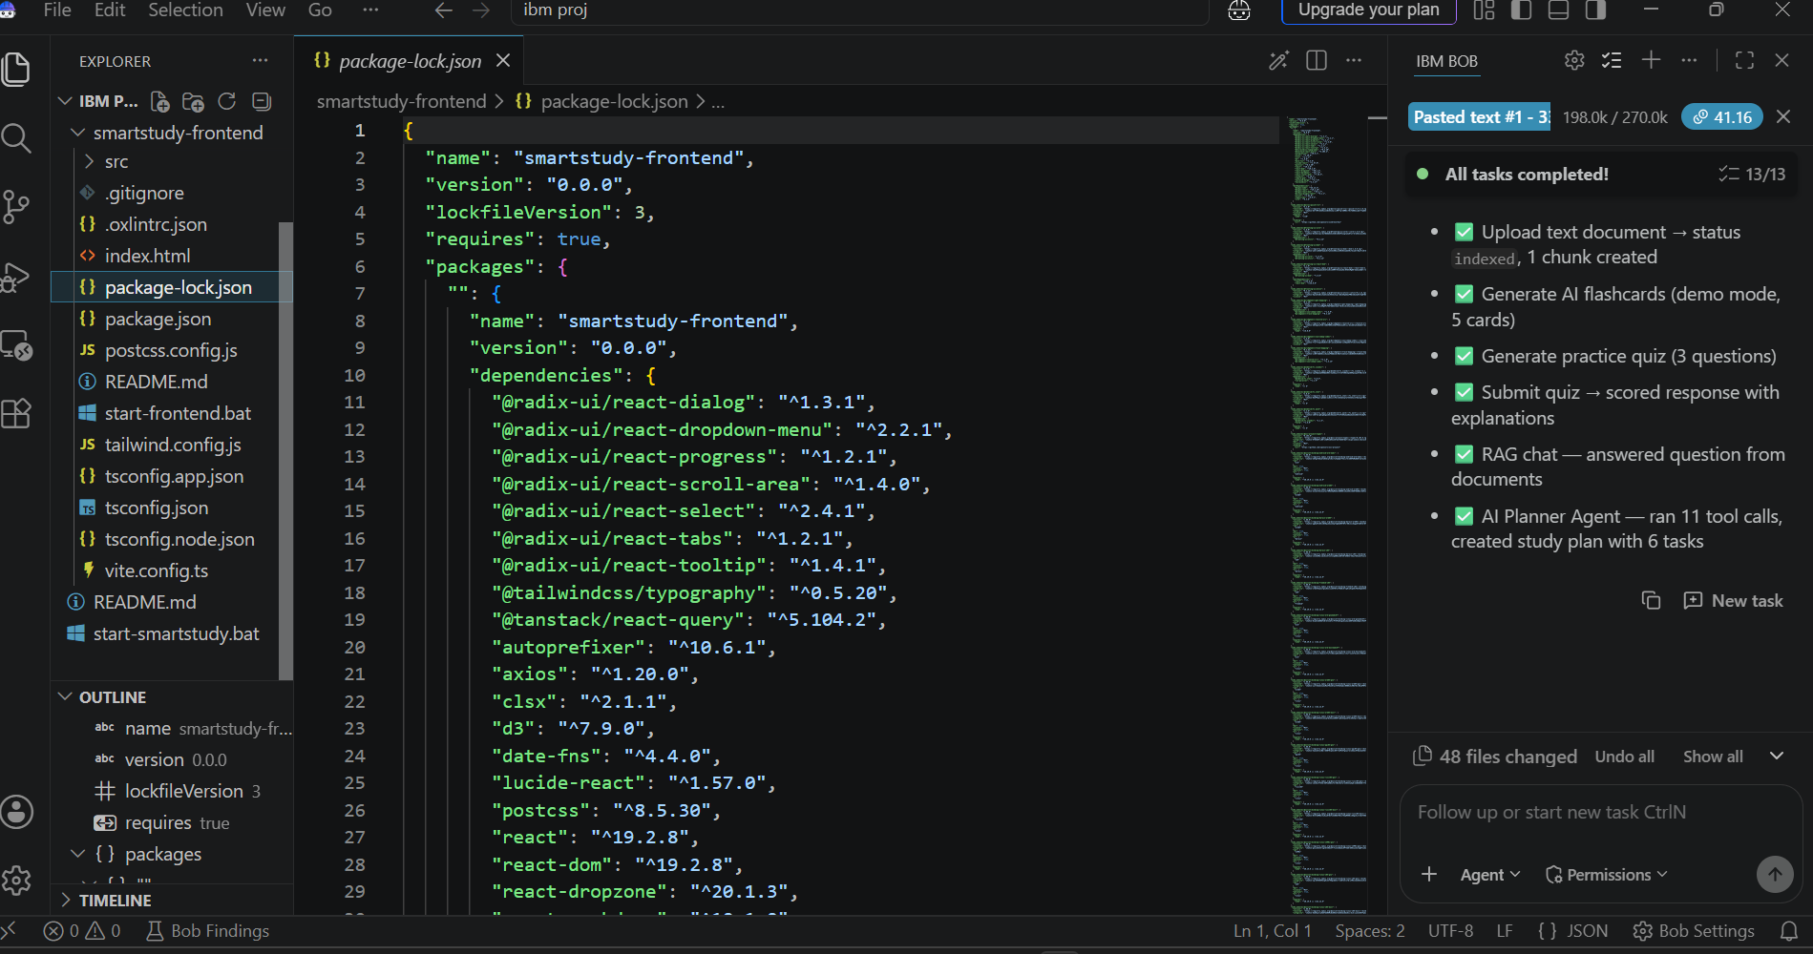
Required Files created using IBM bob -
Frontend — smartstudy-frontend: React-based website with the dashboard, AI Study Generator, flashcards, practice quizzes, study planner, concept maps, and analytics.
Backend — smartstudy-backend:
Python application with main.py, an app folder, requirements.txt, a database file, and a vector-store folder.

Slide 7
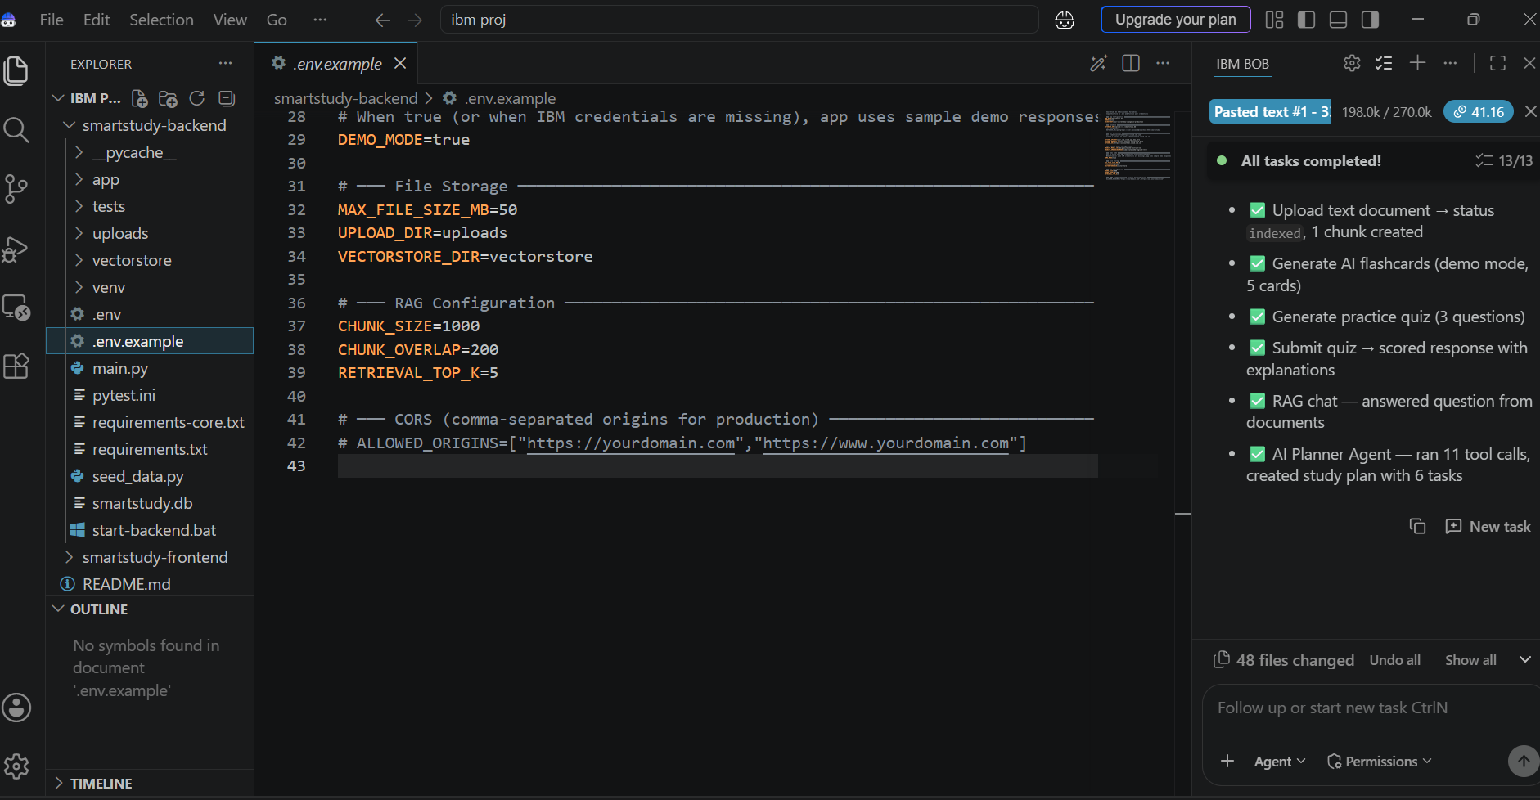
IBM Bob Screenshots:

Slide 8
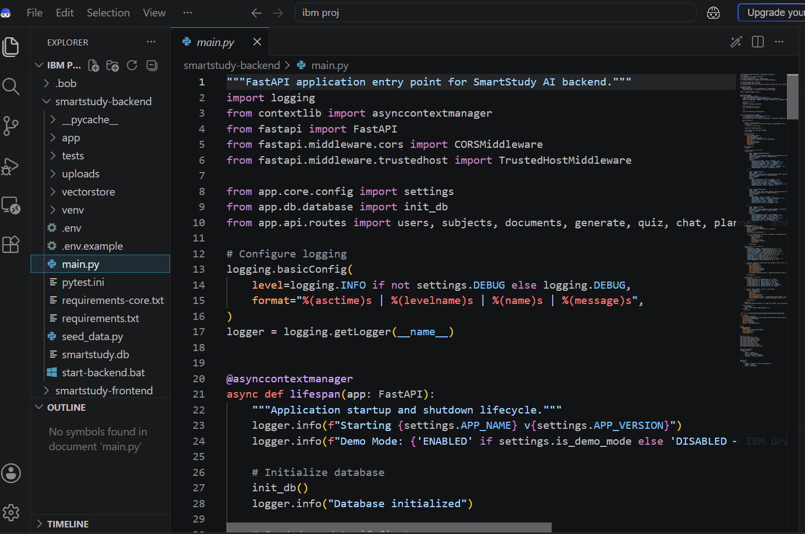

Slide 9
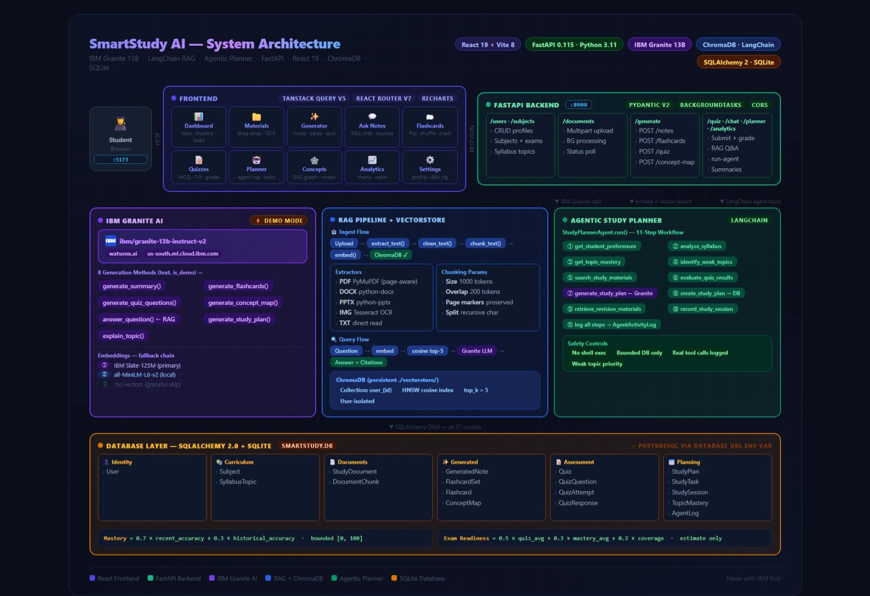
Architecture blueprint for IBM bob:

Slide 10

Role of Agentic AI in the solution
Role of Agentic AI in Smart Study Generator Agent
Agentic AI transforms the Smart Study Generator into an intelligent learning assistant rather than a simple chatbot.
Key Agentic AI Features:
- Autonomous Task Planning: Organizes study activities based on learning goals.
- Multi-Agent Coordination: Coordinates study material generation, quiz creation, doubt solving, and study planning.
- Context Awareness: Understands students’ learning needs and uploaded study notes.
- Tool Usage and Reasoning: Selects appropriate tools to complete learning tasks.
- Adaptive Learning: Identifies weak topics and adjusts recommendations based on quiz performance.
- Continuous Feedback: Uses learning analytics to recommend the next steps for improvement.
These features enable personalized learning, efficient study management, and improved learning outcomes.

Slide 11
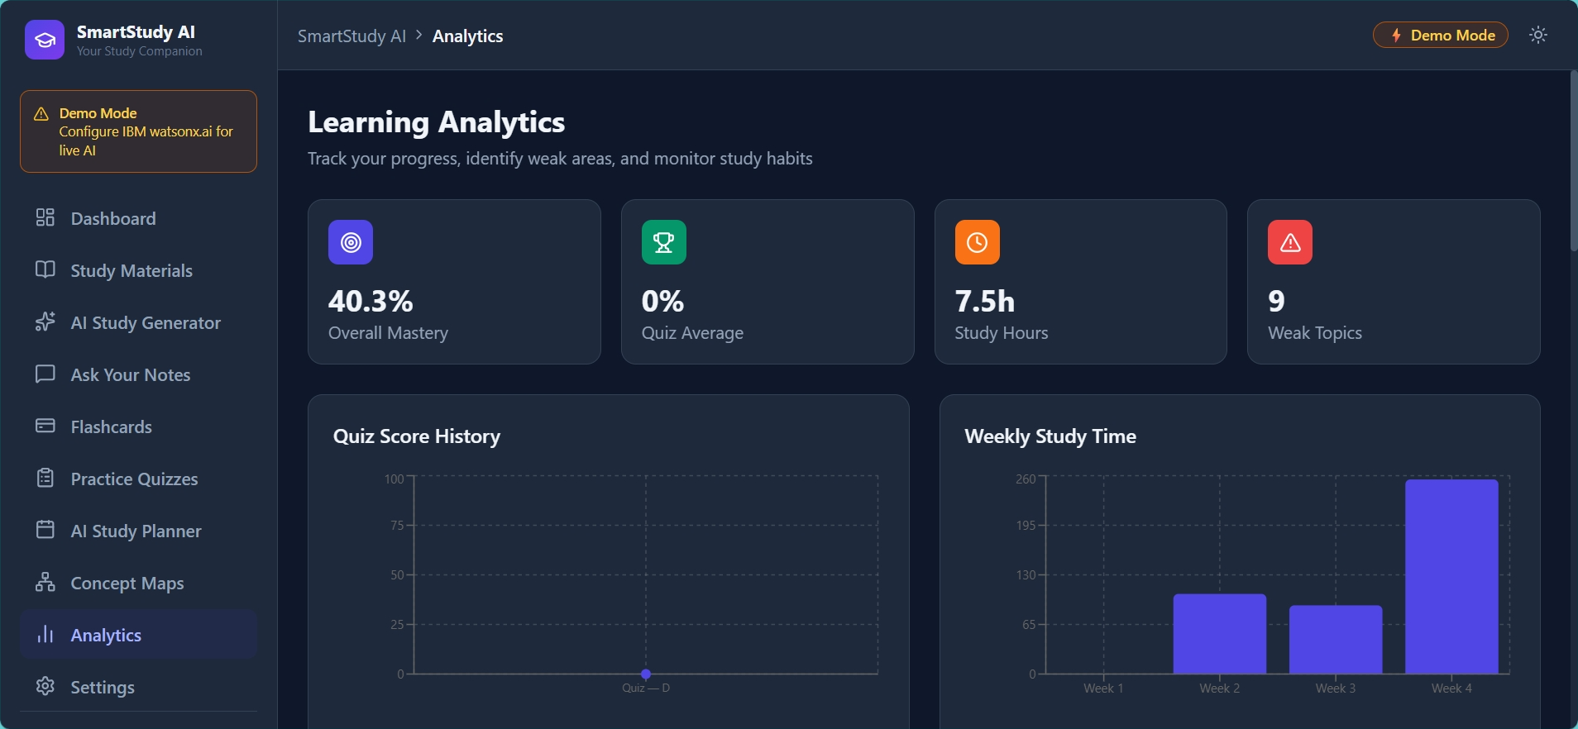
Project Output Screenshot
Please put IBM Bob output screenshots with 2-3 prompts.
You can take 2-3 more slides for each screenshot
·
·
·

Slide 12
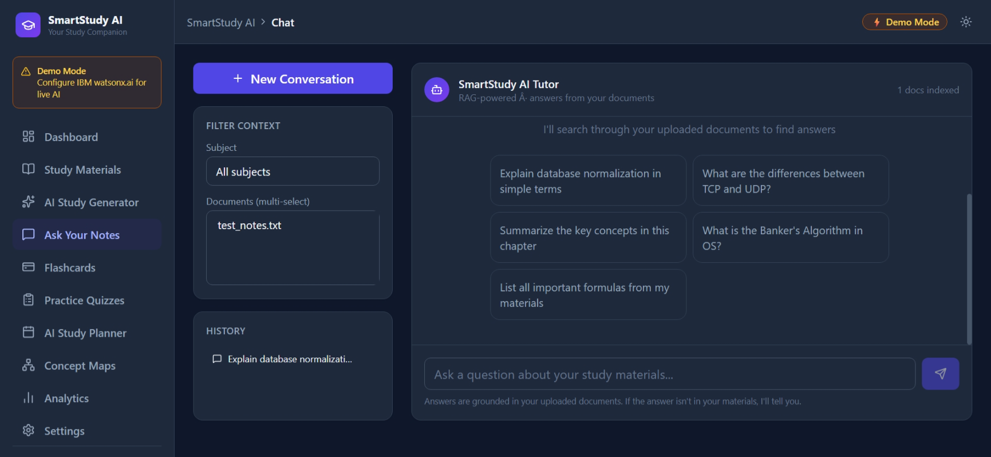
Project Output Screenshot
Please put IBM Bob output screenshots with 2-3 prompts.
You can take 2-3 more slides for each screenshot
·
·
·

Slide 13
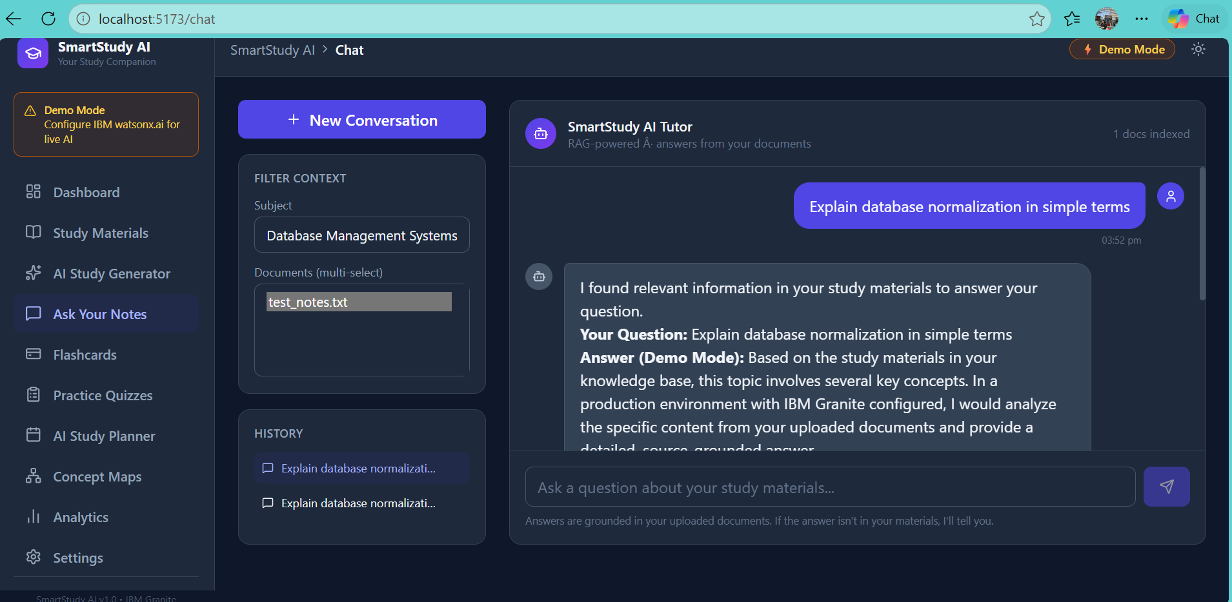
Project Output Screenshot
Please put IBM Bob output screenshots with 2-3 prompts.
You can take 2-3 more slides for each screenshot
·
·
·

Slide 14
Novelty and Uniqueness
Agentic AI Approach: Goes beyond a traditional chatbot by autonomously identifying learning needs and recommending next steps.
Personalized Learning Experience: Generates customized notes, flashcards, quizzes, and study plans based on individual student performance.
RAG-Based Question Answering: Provides context-aware answers from uploaded study materials with relevant source references.
Multimodal Input: Supports multiple learning resources, including PDFs, documents, and textbook images.
Adaptive Weak-Area Detection: Identifies difficult topics from quiz results and recommends targeted revision activities.
Integrated Learning Ecosystem: Combines study material generation, AI tutoring, exam preparation, and progress analytics in one platform.
Continuous Learning Improvement: Updates study recommendations based on quiz performance and completed learning activities.

Slide 15
Git Hub Link
· Please create public github repository (Enable Add README button while creating repository) with format –
Please test and Paste the working Github URL –
Make sure you have Uploaded following three files into your github repository
1) All Agent relevant files of IBM Cloud , 2) yourproblemstatement.pdf file 3) your projectpresntation.pptx file 4)any other files
·
·
·

Slide 16
Future Scope
Advanced Multimodal Learning: Integrate voice commands, speech-to-text, and handwritten note recognition for easier learning.
Personalized AI Learning: Adapt study plans, explanations, and quizzes according to each student's learning pace, strengths, and weaknesses.
Predictive Exam Preparation: Analyze syllabus and previous question papers to identify frequently tested topics and improve exam preparation.
Multilingual Support: Support regional languages to make learning accessible to more students.
Mobile Application Integration: Develop Android and iOS applications for learning anytime, anywhere.
Real-Time Progress Analytics: Provide advanced performance tracking, topic mastery analysis, and personalized improvement recommendations.
Collaborative Learning: Enable students to share study materials, flashcards, notes, and quizzes with classmates.
LMS Integration: Integrate with platforms such as Moodle and Google Classroom for seamless access to academic resources.
·
·
·

Slide 17
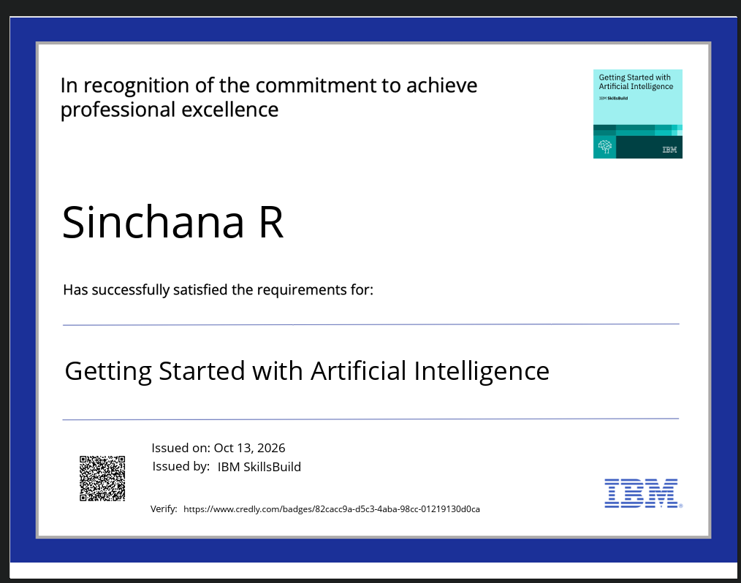
Certificates Earned:

Slide 18
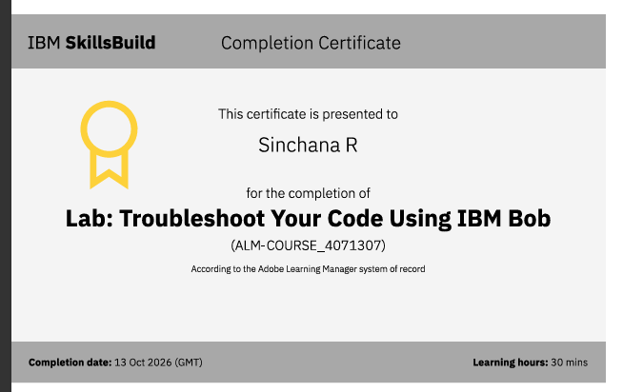
Certificates Earned:​

Slide 19


